Slide 1

Quantamental - The Quant platform
Chitresh Poojary – 22107010
Gaurav Shetty – 23107127
Shlok Sawant – 23107142
Manish Sharma – 23107058
Project Guide
Ms.Richa Singh
Student ID | Group Member
Chitresh Poojary | 22107010
Gaurav Shetty | 23107127
Shlok Sawant | 23107142
Manish Sharma | 23107058
Notes:
‹#›

Slide 2
Outline
Introduction
Literature Survey of the existing systems
Limitations of the existing systems
Problem statement
System Design
Technologies and methodologies
Implementation
Conclusion
References
Notes:
‹#›

Slide 3
Sustainable Development:
SDG 8: Decent Work and Economic Growth
Promotes financial literacy by simplifying access to quantitative and fundamental analysis.
Provides better access to market data for individuals and small investors.
Empowers users to make informed investment decisions, contributing to sustainable economic growth.
Supports entrepreneurship and financial independence by lowering barriers to advanced investing tools.
SDG 9: Industry, Innovation, and Infrastructure
Integrates AI-driven insights, stock dashboards, and portfolio tracking in one unified platform.
Encourages fintech innovation by combining machine learning, real-time data, and explainability.
Strengthens digital financial infrastructure that can scale from individuals to businesses.

Slide 4
Introduction
In today’s dynamic financial world, investors need speed, accuracy, and personalization in decision-making.
Quantamental revolutionizes investing by integrating:
  Quantitative analysis : Data driven models, indicators, and trends
  Fundamental research : Financial statements, industry outlooks, and market news
An innovative stock analysis and recommendation system offering:
  Real time market data
  Built in CLI for stock price & indicator tracking
  AI powered personalized insights (based on age, holdings, and risk profile)
Utilizes machine learning, sentiment analysis, and mathematical models to generate reliable and explainable recommendations.

Slide 5
Introduction
Objective:
To provide a platform that combines quantitative analysis and fundamental research for smarter investment decision making.
To assist users in constructing and managing optimized investment portfolios using machine learning algorithms like LSTM , Bollinger bands and Moving averages with market data support from yfinance.
To simplify financial research by aggregating news, analysis, mathematical tools, recommendation system and chatbot-based advisory support in one unified interface.
To integrate real-time market data and predictive analytics to help users make timely, data-driven investment decisions with greater precision and confidence.
Notes:
‹#›

Slide 6
Literature Survey of the existing system
Sr. no | Title | Author(s) | Year | Outcome | Methodology | Result
1. | Embracing Fundamental and Quant Investing in Emerging Markets | Robeco Research Team | 2024 | Showed industry adoption of quantamental investing in emerging markets. | Combination of factor models (value, momentum) with fundamental analyst overlays. | Demonstrated that blending quant + fundamental improved stock selection in emerging markets, but methodology was proprietary and not reproducible academically.
Notes:
‹#›

Slide 7
Literature Survey of the existing system
Sr. no | Title | Author(s) | Year | Outcome | Methodology | Result
2. | Quant 4.0: Engineering Quantitative Investment with Automated, Explainable and Knowledge-driven AI | Jian Guo, Shum H-Y., et al. | 2022 | Proposed a new paradigm, Quant 4.0, to move beyond traditional quantamental by embedding explainability, automation, and domain knowledge into investment models. | Applied Explainable AI (XAI) tools (e.g., SHAP, LIME), knowledge graphs, and automated model pipelines. Emphasized governance and transparency in model outputs. | Showed that adding knowledge-driven AI and explainability improved trust and interpretability of quant models. Noted that large-scale real-world deployment was still unproven, leaving room for practical validation.
3. | Quantamental Investing: A Machine Learning Investment Process | Gattaiah Tadoori | 2020 | Proposed an ML driven quantamental process integrating AI insights with human judgment. | Built a quantamental pipeline with data collection, feature engineering, ML models, and portfolio optimization, validated via cross-validation. | ML-based quantamental strategies outperformed standalone factor models but lacked explainability, limiting trust.
Notes:
‹#›

Slide 8
Limitations of existing systems
Fragmented Platforms
Existing tools often separate price data, portfolio tracking, and financial news across multiple platforms. Our project integrates all into a single solution (real-time data + CLI + news + AI).
Limited Real-Time Deployment
Many academic models remain at theoretical/backtest level, without live usability. Our system offers a live CLI and web app with real-time API data.
High Cost & Limited Accessibility
Professional platforms (Bloomberg, Refinitiv) are too expensive for individuals and small firms.Quantamental provides an affordable, accessible, and easy-to-use alternative.
Notes:
‹#›

Slide 9
Problem statement
Effective investing requires combining quantitative analysis (data models, indicators, and trends) with fundamental research (financial statements, industry outlooks, and news).
Investors currently face fragmented platforms one for stock prices, another for portfolio tracking, and yet another for financial news leading to inefficiency and missed insights.
Existing professional platforms (e.g., Bloomberg, Refinitiv) provide comprehensive solutions but are extremely expensive (thousands of dollars annually) . Complex to use, designed primarily for institutional investors

Slide 10
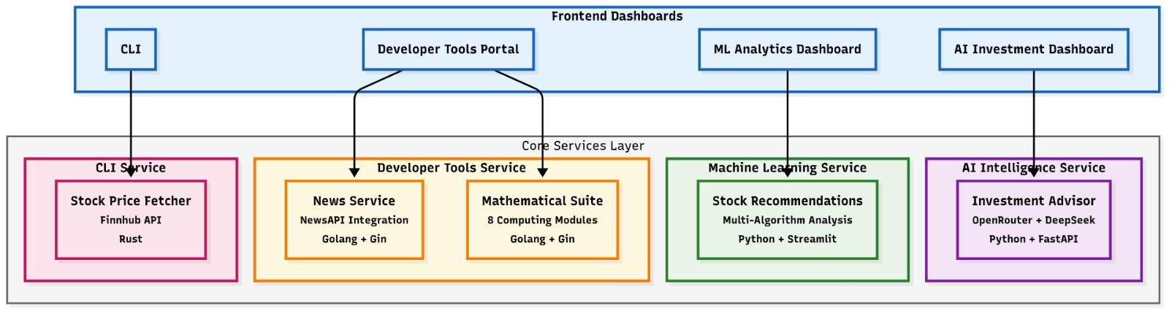
System Design
Notes:
‹#›

Slide 11
Technologies and methodologies
Technology Stack:
Backend: Go : API management, business logic, and real-time data processing
CLI Tools: Rust command line interface for stock/crypto prices
Frontend: TypeScript (Nextjs) interactive and responsive user interface
ML/Analytics : Python for advanced predictions and trend analysis
Automation Scripts: Bash for running scripts
Notes:
‹#›

Slide 12
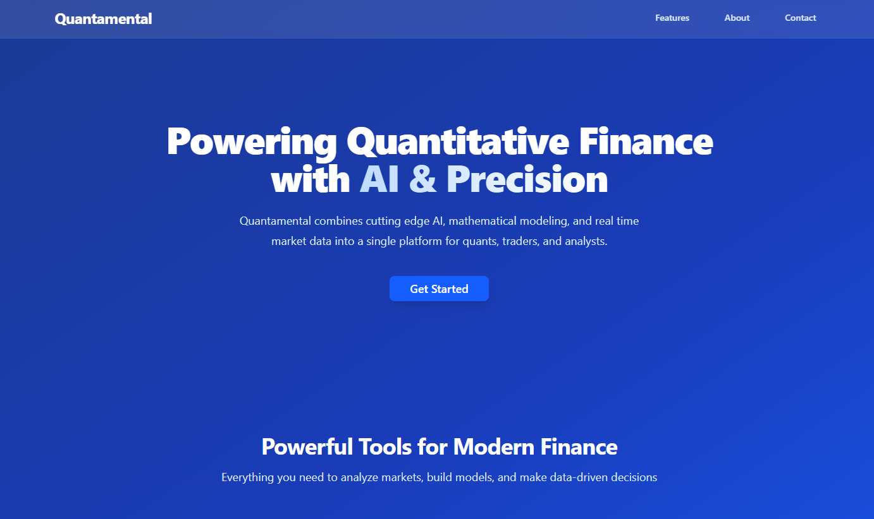
Implementation
Landing Page:
Notes:
‹#›

Slide 13

DASHBOARD:

Slide 14
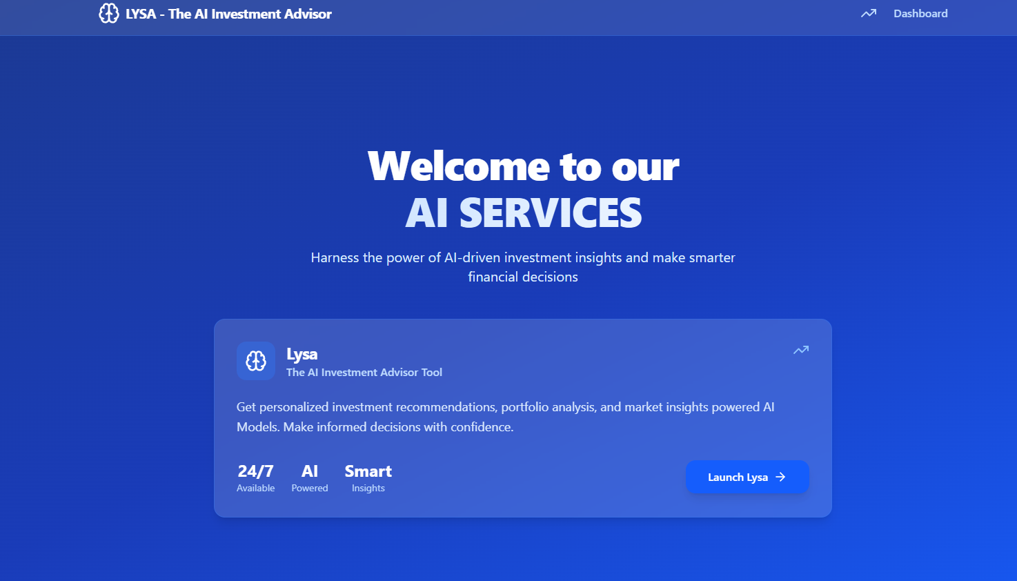
Lysa-ai services

Slide 15
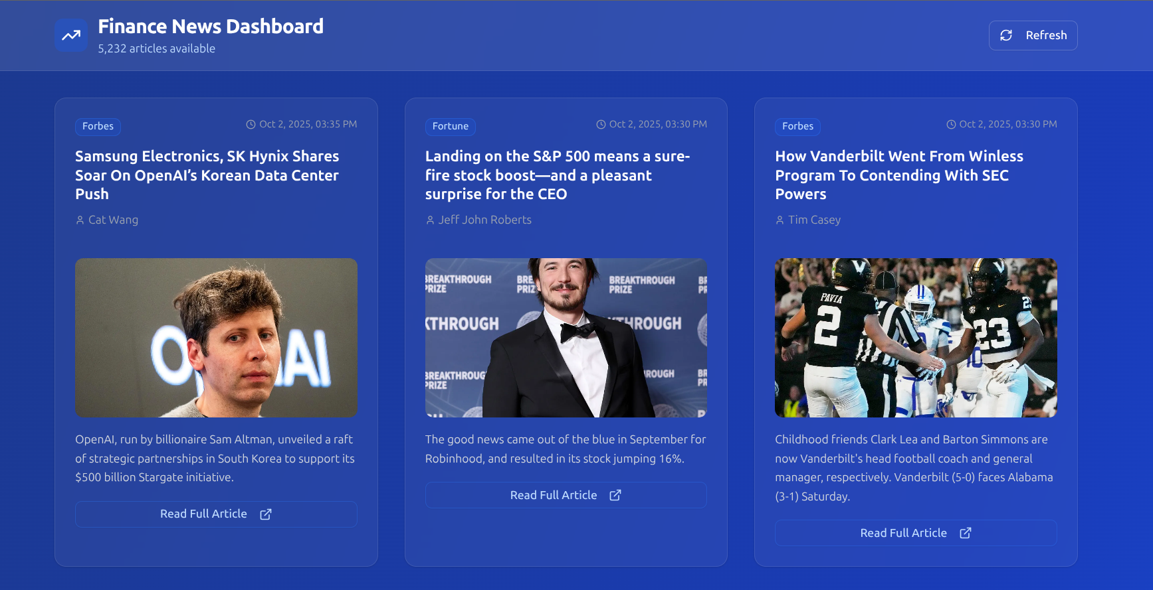
DEVELOPER TOOLS

Slide 16
Conclusion
Quantamental offers a unified financial platform to overcome fragmentation.
Integrates dashboards , portfolio management , news aggregation in one tool.
Implemented the full project with deployment
Notes:
‹#›

Slide 17
References
[1] Tadoori, G. (2020). Quantamental Investing: A Machine Learning Investment Process.
SSRN. Available at: https://papers.ssrn.com/sol3/papers.cfm?abstract_id=3609896
[2] Guo, J., Wang, S., Ni, L. M., & Shum, H.-Y. (2022). Quant 4.0: Engineering Quantitative Investment with Automated, Explainable and Knowledge-driven AI.
Frontiers of Information Technology & Electronic Engineering, 23(12), 1703–1718. doi:10.1631/FITEE.2200160
[3] Robeco Research Team. (2024). Embracing Fundamental and Quant Investing in Emerging Markets.
Robeco Industry White Paper. Available at: https://www.robeco.com
Notes:
‹#›

Slide 18
Thank You...!!
Notes:
‹#›

